Slide 1
Windows Store in Ukraine
ALEKSANDR KRAKOVETSKYI
CEO, DevRain Solutions
Microsoft RD/MVP, PhD., @msugvnua
http://wp7rocks.com

Slide 2
Windows 8 Launch
$49 personal registration, $99 for companies;
startups, MSDN Subscribers can register for free;
Payoneer, Virtual cards not working;
Need to disable CVV2 validation;
UAH paid to bank.

Slide 3







Partners
thank you!

Slide 4
DevRain Solutions: 1 million downloads
ALEKSANDR KRAKOVETSKYI
CEO, DevRain Solutions
Microsoft RD/MVP, PhD., @msugvnua
http://wp7rocks.com

Slide 5
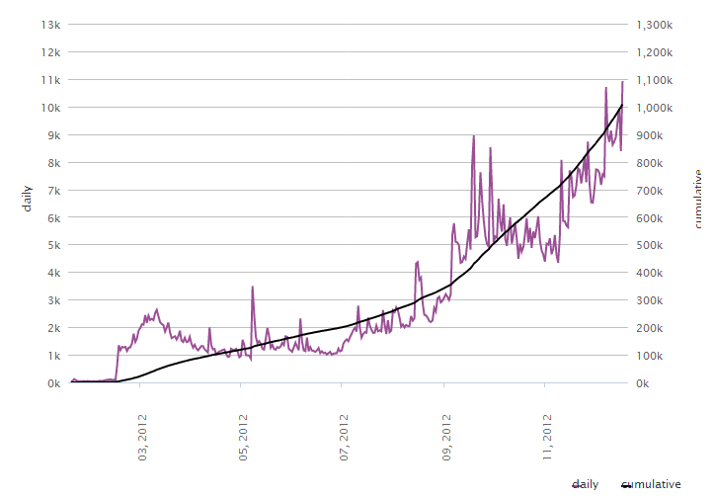
Statistics
Total app downloads for the selected criteria: 1,008,443

Slide 6
Top downloaded apps
Lomogram 592,391
Undead Carnage 222,224
Undead Carnage: Redemption 88,210
Bug Invasion 51,710
Задолбали 30,928

Slide 7
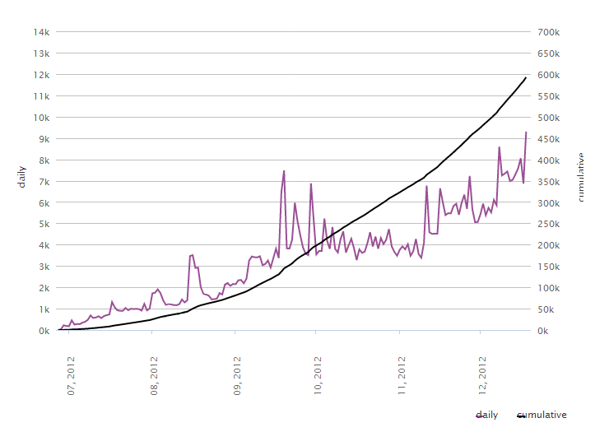
Lomogram (downloads)

Slide 8
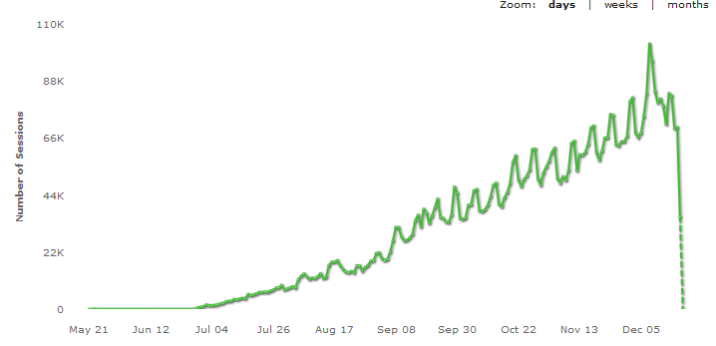
Lomogram (sessions)
Peek: 102k per day

